Slide 1
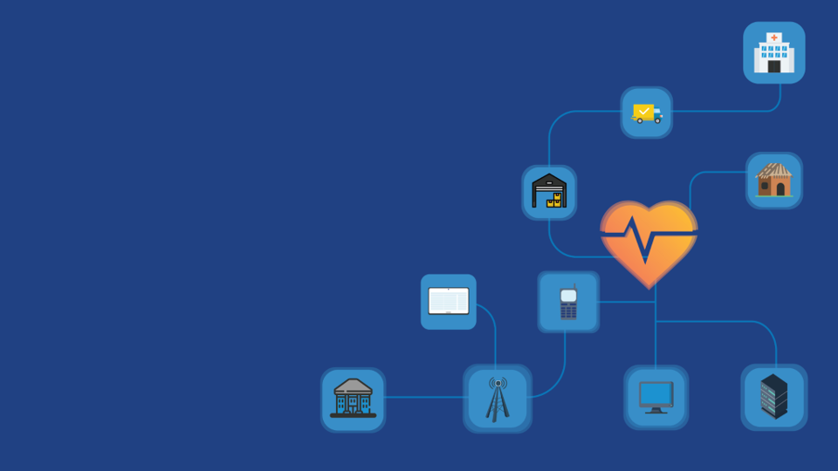
Introduction to
Digital Health:
Planning National Systems
Notes:
ENGAGEMENT:
TRANSITION:
RECAP:
ANECDOTE:
Speaker Notes:
Citation:

Slide 2
Two key take away
Develop
a holistic, systems-level approach to digital health and be able to define and critique trade-offs among investments and activities.
Lead a national digital health planning process and make connections to specific health challenges and opportunities in-country.
Notes:
ENGAGEMENT:
TRANSITION:
RECAP:
ANECDOTE:
Speaker Notes:
Citation:

Slide 3
Introduction to Digital Health
What is digital health?
Digital Health
Digital
Health
(of signals or data) expressed as series of the digits 0 and 1, typically represented by values of a physical quantity such as voltage or magnetic polarization. (Merriam-Webster)
Health is a state of complete physical, mental and social well-being and not merely the absence of disease or infirmity. (WHO)
Notes:
ENGAGEMENT:
TRANSITION:
RECAP:
ANECDOTE:
Speaker Notes:
Citation:

Slide 4
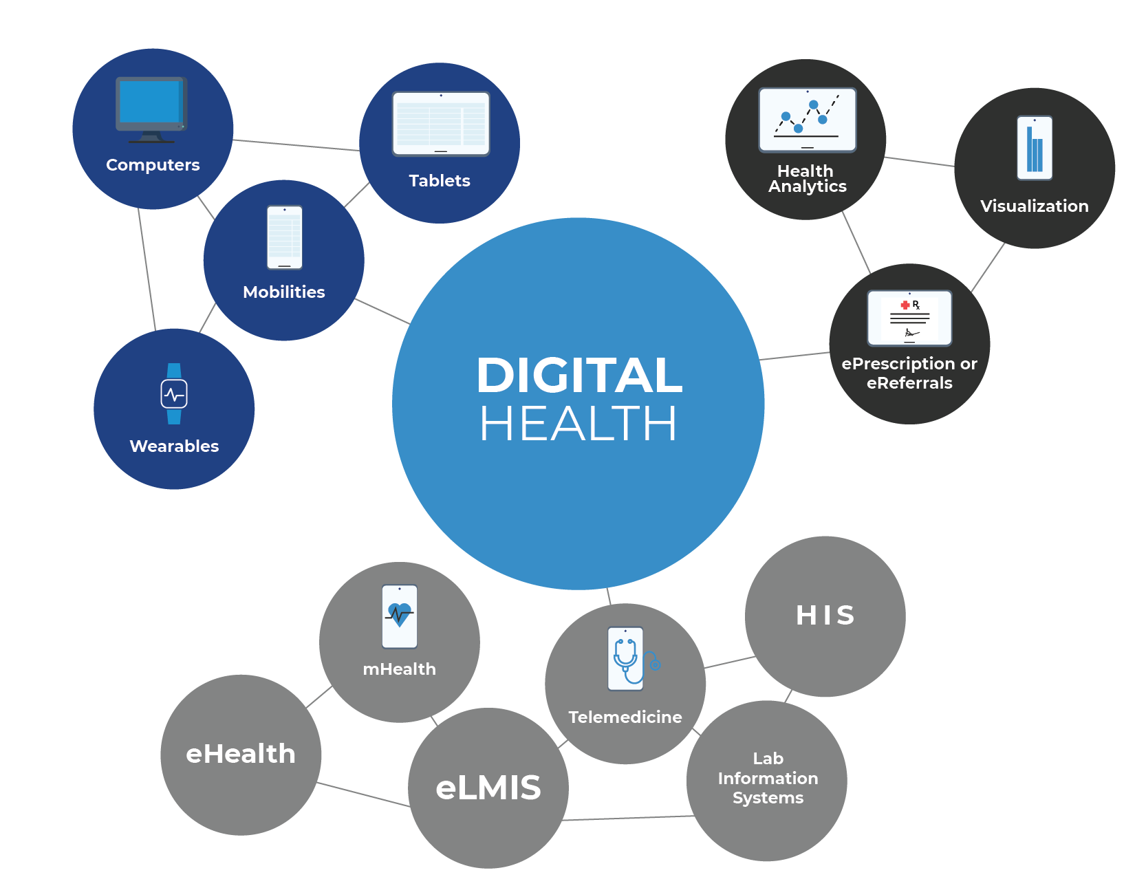
Introduction to Digital Health
What does digital health encompass?
Digital health
encompasses all concepts and activities at the intersection of health and information and communications technologies (ICTs).
Notes:
ENGAGEMENT: Get the class to list the bullets below by asking them the things they think encompass ‘digital health’: (If you were to put some bubbles onto this graphic, what would they say?)
mhealth
ehealth
his/hmis
telemedicine/telehealth
elmis
lab systems
EMRs
decision support
informatics (medical and health)
big data/ai for health
TRANSITION:
RECAP:
ANECDOTE:
Speaker Notes: (Digital health encompasses all concepts and activities at the intersection of health and information and communications technologies (ICTs). This includes the subdomains of)
mHealth, which usually refers to front-end, client-facing, mobile device-based applications and services,
eHealth, including electronic system, such as HMIS and eLMIS) for patients, providers, and health systems administrators, as well as digital financial services, including banking, insurance, payment services accessed through mobile phones, electronic cards, and vouchers. Digital health is defined in the 2017 Broadband Commission report as encompassing three main functions:
the delivery of health information, for health workers and health consumers, through the internet and telecommunications media;
the use of ICTs to improve public health and clinical services (e.g. through the education and training of health workers);
the use of health management and information systems to capture, store, manage, or transmit information on patient health or health facility activities to improve health outcomes.
The domain of digital health also encompasses the use of emerging technologies such as machine learning, artificial intelligence, and blockchain; however these are not the focus of this inaugural USAID Digital Health Vision.
Citation:

Slide 5
Introduction to Digital Health
What is digital health?
Digital Health
Digital health is the use of information and communications technologies (ICTs) by individuals, health providers, and health systems to improve health outcomes and strengthen health systems. This includes the effective use of technologies and the data they generate to enhance the demand, access, coverage, delivery, quality, and affordability of health information and service delivery for all.
Notes:
ENGAGEMENT:
TRANSITION:
RECAP:
ANECDOTE:
Speaker Notes:
Citation: WHO DHIG

Slide 6
The benefits of digital health
When scaled up, digital health can be a strategic tool for improving access, expanding coverage for UHC, and increasing the financial efficiency of health care systems etc.
IMPROVING
ACCESS
EXPANDING COVERAGE FOR UHC
INCREASING FINANCIAL EFFICIENCY OF HEALTH CARE SYSTEMS
SUPPORTING EQUITY AND QUALITY IN HEALTH CARE
Notes:
ENGAGEMENT:
TRANSITION:
RECAP:
ANECDOTE:
Speaker Notes:
When scaled up, digital health can be a strategic tool for improving access, expanding coverage for UHC, and increasing the financial efficiency of health care systems etc.
Access to essential medicines and health technologies is one of the cornerstones of universal health coverage. Digital health solutions, medical and assistive devices are critical components of health technology, and have the potential to save lives and enhance the quality of life and wellbeing of people.
One of the pillars of UHC is access to essential medicines and appropriate health technologies. Medical devices and Digital health solutions are important components of health technology.
They avail the potential to save lives and improve quality of life and well-being among people.
Many people suffer because of lack of access to high quality, affordable health technologies. This is especially more also in low- and middle-income countries. Digital health strives to ensure that there is equity in health care, aiming at leaving no one behind.
Citation:

Slide 7
HEALTH SYSTEM STRENGTHENING
THE NATIONAL DIGITAL HEALTH
PLANNING PROCESS
01
02
03
04
05
07
08
WHAT IS
DIGITAL HEALTH
HEALTH INTERVENTIONS
DIGITAL
HEALTH
INTERVENTIONS
NATIONAL
DIGITAL
HEALTH
STRATEGY
DIGITAL HEALTH ENTERPRISE
DIGITAL HEALTH
PLATFORM
IMPLEMENTATION
GOVERNANCE
POLICY & REGULATION
WORKFORCE
THE FUTURE
OF DIGITAL HEALTH
ARCHITECTURE
PLATFORM
APPLICATIONS
(global goods)
INTEROPERABILITY
& STANDARDS
06
DIGITAL HEALTH
INTERVENTION
IMPLEMENTATION & COSTING
Notes:
ENGAGEMENT:
TRANSITION:
RECAP:
ANECDOTE:
Speaker Notes:
Citation:

Slide 8
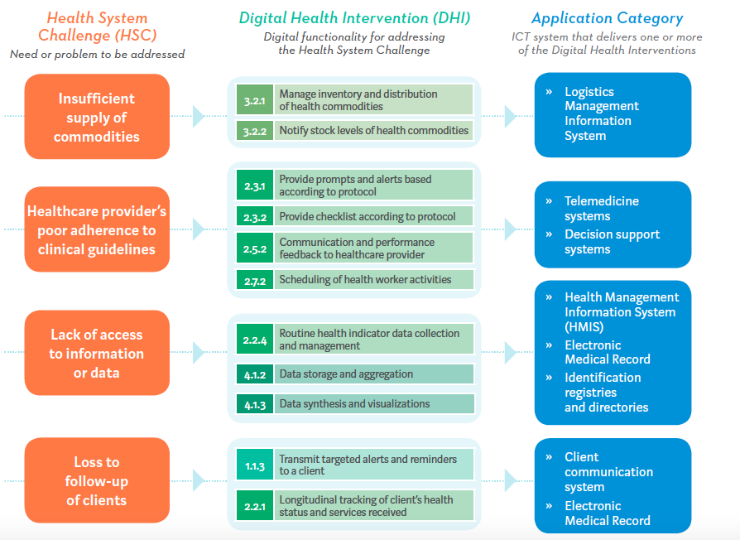
Linkage between health challenge and digital health interventions
| Section 2: Digital Health System Strengthening
Notes:
ENGAGEMENT:
TRANSITION:
RECAP:
ANECDOTE:
Speaker Notes: FOCUS in on “loss to follow-up” health system challenge.
Citation:

Slide 9
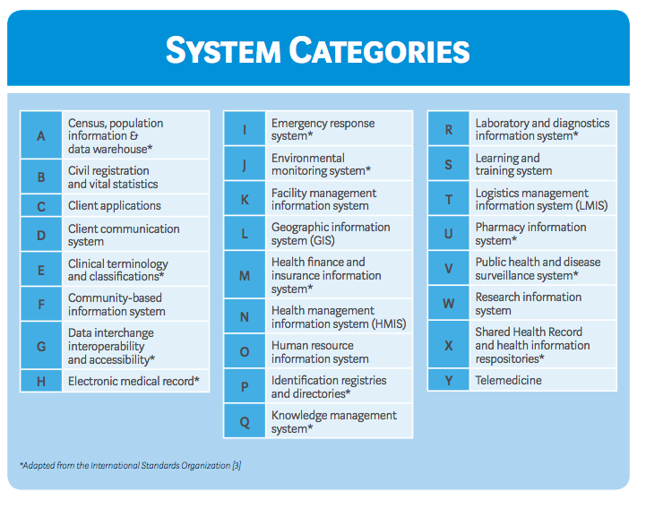
Digital health Systems
| Section 2: Digital Health System Strengthening
Notes:
ENGAGEMENT:
TRANSITION:
RECAP:
ANECDOTE:
Speaker Notes:
Citation:

Slide 10
Section 2
Application of digital health
Notes:
ENGAGEMENT:
TRANSITION:
RECAP:
ANECDOTE:
Speaker Notes:
Citation:

Slide 11
Users of Digital Health tools
Clients are members of the public who are potential or current users of health services, including health promotion activities. Caregivers of clients receiving health services are also included in this group.
Healthcare providers are members of the health workforce who deliver health services.
Health system and resource managers are involved in the administration and oversight of public health systems. Interventions within this category reflect managerial functions related to supply chain management, health financing, human
resource management.
This consists of cross-cutting functionality to support a wide range of activities related to data collection, management, use, and exchange.
World Health Organization (WHO). Classification of Digital Health Interventions V1.0. Geneva, Switzerland: WHO; 2018. License: CC BY-NC-SA 3.0 IGO http://www.who.int/reproductivehealth/publications/mhealth/classification-digital-health-interventions/en/
Notes:
ENGAGEMENT: What other audiences can you think of?
TRANSITION:
RECAP:
ANNECDOTE:
Speaker Notes: WHO defines four major user groups of digital health tools. Clients include patient and caregivers. Apps for them might be messaging or scheduling tools. Healthcare providers include both formal health care workers as well as informal ones such as CHWs or TBAs or even people such as workers at pharmacies who end up providing health care though it is not their job. Example of Open SRP. Health system manager include people like the facility manager or district manager as well as staff who were in the national Ministry of Health. It can also include people who manage systems like supply chain or human resources. Data systems refer to tools that exist to provide other tools with information.
Citation:
World Health Organization (WHO). Classification of Digital Health Interventions V1.0. Geneva, Switzerland: WHO; 2018. License: CC BY-NC-SA 3.0 IGO http://www.who.int/reproductivehealth/publications/mhealth/classification-digital-health-interventions/en/

Slide 12
Section 3: Contextualizing Digital Health
Subsection 1
Users & Health Journeys
Notes:
ENGAGEMENT:
TRANSITION:
RECAP:
ANECDOTE:
Speaker Notes:
Citation:

Slide 13
What is a health journey?
A health journey, put simply, describes how a patient moves through the different stages of care
Notes:
ENGAGEMENT:
TRANSITION:
RECAP:
ANECDOTE:
Speaker Notes:
Citation:
Facilitator’s note: personalize with own examples of health journeys

Slide 14
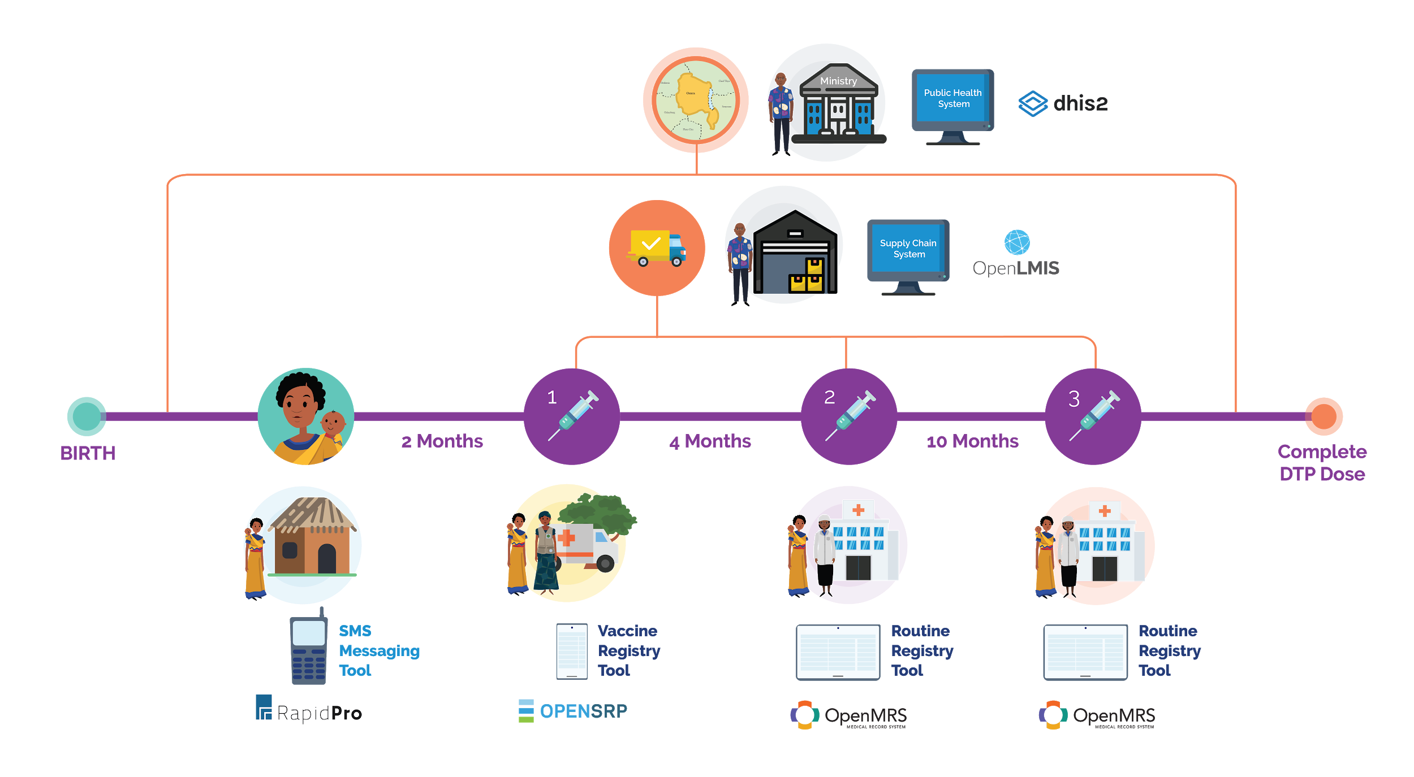
Complete Digital Health Journey
Notes:
ENGAGEMENT:
TRANSITION: In order to make this happen you need to focus on much more than just the digital tools.
RECAP:
ANECDOTE:
Speaker Notes:
Citation:

Slide 15
Section 3: Contextualizing Digital Health
Subsection 2
The Enabling Environment
Notes:
ENGAGEMENT:
TRANSITION:
RECAP:
ANECDOTE:
Speaker Notes:
Citation:

Slide 16
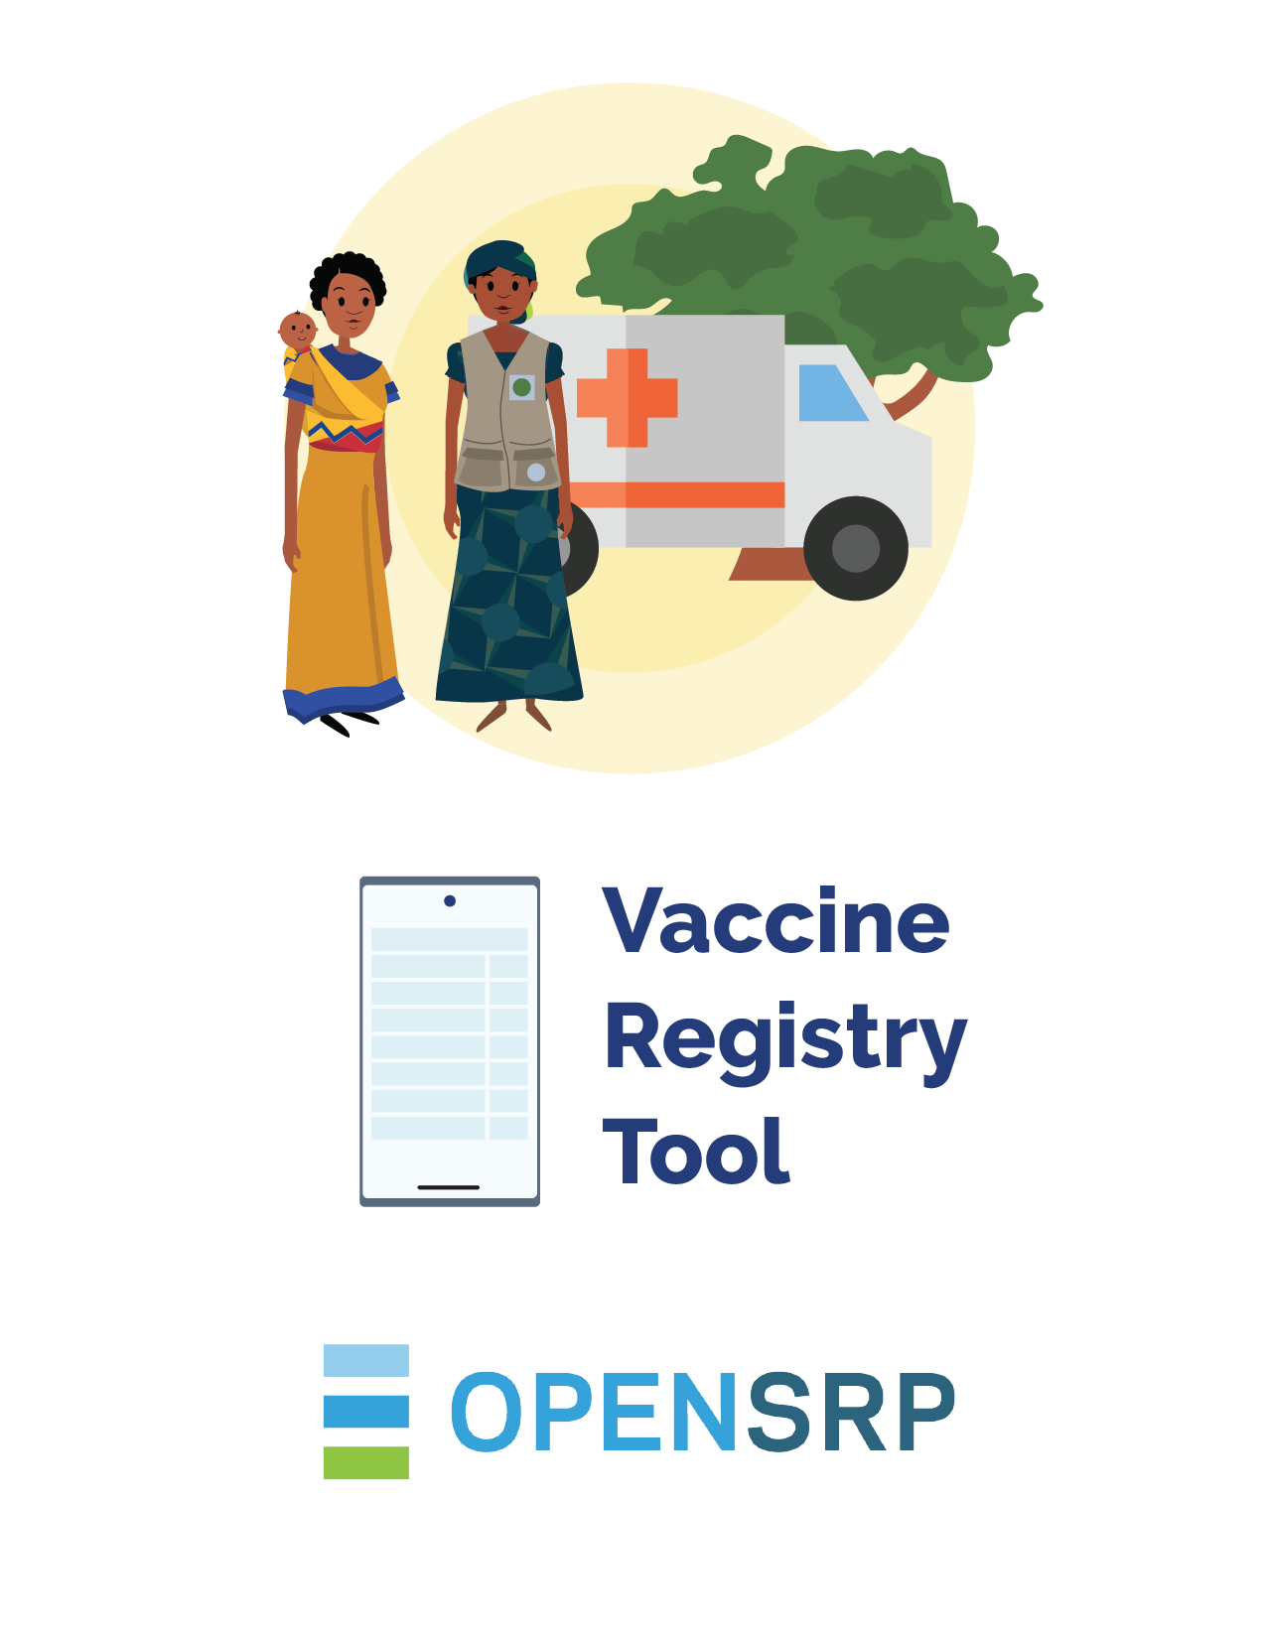
The most common way people think of Digital Health is by thinking about the Software Application

Slide 17
But as a government leader and planner, you need to think about many different elements that need to be invested in for the health worker to use the software application.

Slide 18
Here are a few of the questions you need to ask
Is this software application official and being driven by ministry leadership? If not what are the processes for determining which software applications are official?
Has the government or partner planned for a way for the software application to continue to be used after the current project funding ends?
Are there other applications in the country that do the same thing as this one, which are already scaled at a national level?
Are there national policies or regulations about any of the data being collected in the application?
If you wanted to get other workers to use this software application how would you train them? What if new features were added to the application? How would you teach all the workers how to use the new parts?
How does this application share it’s data with other applications? Is there a standardized way to do so?
Can you use this software at every clinic? Do you need power or connectivity?
eHealth Strategy Toolkit
Notes:
ENGAGEMENT:
TRANSITION: In order for these platforms to exist and be utilized a full ecosystem approach needs to be invested in.
RECAP:
ANECDOTE:
Speaker Notes:
Citation:

Slide 19
WHO says there are 7 areas that need to be thought about. Each of the questions we asked maps to one of those areas. We call the full set of these areas The Enabling Environment.
LEADERSHIP AND GOVERNANCE
Strategy and
Investment
Services and Applications
Legislation,
Policy and
Compliance
Workforce
Standards and Interoperability
Infrastructure
eHealth Strategy Toolkit
Notes:
ENGAGEMENT:
TRANSITION: In order for these platforms to exist and be utilized a full ecosystem approach needs to be invested in.
RECAP:
ANECDOTE:
Speaker Notes:
Citation:

Slide 20
Section 3
Current state digital health
challenges
Notes:
ENGAGEMENT:
TRANSITION:
RECAP:
ANECDOTE:
Speaker Notes:
So if digital health
Citation:

Slide 21
The current paradigm of digital health is challenged by a lack of connection and synchronization between different digital health interventions. When these digital interventions cannot effectively communicate with each other, they also cannot communicate with government leaders and ministry officials who need that information to make the most evidence-based public health decisions.
Notes:
ENGAGEMENT:
TRANSITION:
RECAP: now that we understand what a digital health platform is how does a country go about implementing a platform.
ANECDOTE:
Speaker Notes:
Citation:

Slide 22
What is the danger of fragmentation?
Digital Health Programs have mostly been implemented as vertical siloed applications financed by different donors and government programs.
Fragmentation occurs when the focus is on applications as opposed to an enterprise approach.
Fragmentation of digital health
Digital Health Application
Digital Health Application
Digital Health Application
Digital Health Application
Notes:
ENGAGEMENT: Question to trainees: what are some issues you can think of from your own work?
Historical development of digital approaches has led to an intervention focus and siloed applications. What are the dangers of fragmentation?
TRANSITION:
RECAP:
ANECDOTE:
Speaker Notes: Fragmentation of Digital Health Investments leads to: Routine planning, management, and service delivery decision-making at central, sub-national, and facility/community levels is insufficiently and inconsistently driven by data. This results in chronic mis-allocation of health resources, poor targeting and under-performance of health programs, and ineffective and inefficient services, as well as the inability to even recognize, let alone address performance challenges.
Short term wastage of funds due to development and maintenance costs of parallel systems
Long term wastage of funds do to the difficulty of legacy integration of existing unplanned systems
Not enough funding to go around to support the platforms that do exist
Citation:

Slide 23
Fragmentation: Absence of Platforms Approach - Immunization Example
?
Notes:
ENGAGEMENT:
TRANSITION:
RECAP:
ANECDOTE: It might be worth mentioning that this is a problem specifically if the mother does not have a immunization card because she loses it or the facility does not enter the data.
Speaker Notes:
Citation:

Slide 24
The harms of fragmentation
Planning | Service Delivery | Financing
- Insufficiently and inconsistently driven by data | - Ineffective and inefficient services | - Short term waste due to development and maintenance costs of parallel systems
- Mis-allocation of health resources | - Inability to address performance challenges | - Long term waste due to the difficulty of legacy integration of existing unplanned systems
- Poor targeting and under-performance of health programs | - Overlapping and inconsistent training and increased burden on health workforce | - Shortages in support for the platforms that do exist
- Inability to scale and sustain platforms
All of this leads to reduced health impact
Notes:
ENGAGEMENT:
TRANSITION:
RECAP:
ANECDOTE:
Speaker Notes: emphasize that affects planning, service delivery and financing (go into an example of at least one) - it is not just a waste of money, it also limits service delivery and hinders national planning. It detrimentally affects the audience who is ‘higher up on the food chain’ - at the highest levels of national management.
Citation:Derived from two sources:
Presentation on Digital Health the EAC, Merrick Schaefer 2018
ITU Digital health platform guide

Slide 25
Section 5
Shifting the Current Paradigm
Zanzibar Digital health Strategy 2020 – 2024
Notes:
ENGAGEMENT:
TRANSITION:
RECAP:
ANECDOTE:
Speaker Notes:
So if digital health
Citation:

Slide 26
In order to shift the current paradigm, it is crucial to use and “enterprise approach” to make the systems interoperable so that they can communicate effectively.
To do this well, it is important to consider building a digital health platform, which serves as the foundation for the country’s digital health applications and enables interoperability between them.
Notes:
ENGAGEMENT:
TRANSITION:
RECAP: now that we understand what a digital health platform is how does a country go about implementing a platform.
ANECDOTE:
Speaker Notes:
Citation:

Slide 27
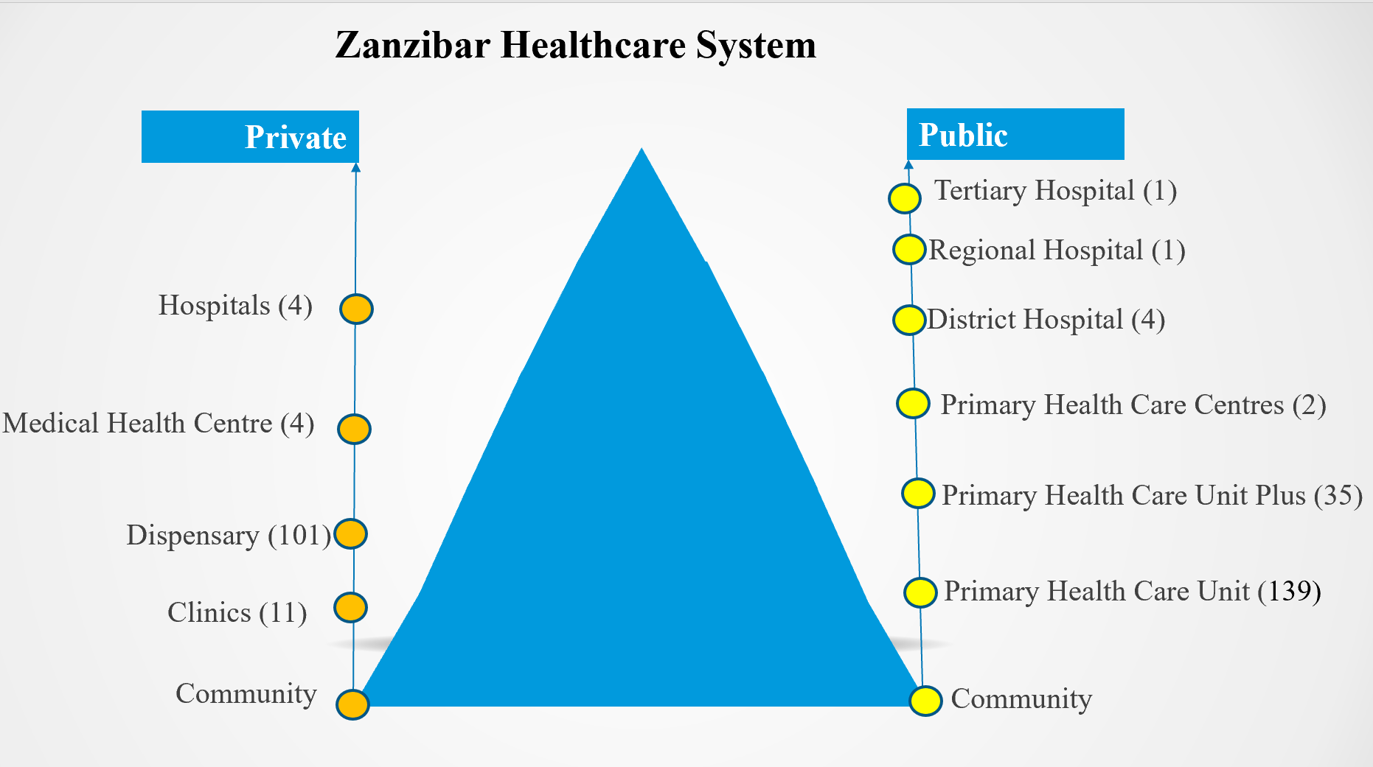
A vision to move away from fragmentation
Established country governance through collaborative processes led by government which yields national strategies and implementation plans, enterprise architecture, enabling interoperability and use of global good applications to implement evidence based digital health interventions to improve health outcomes.
Notes:
ENGAGEMENT:
TRANSITION: By the end of this course, you should understand all of the concepts in this sentence
RECAP:
ANECDOTE:
Speaker Notes: This may sound like gibberish right now, but by the time we revisit this at the end of the course, these terms should all be familair to you.
Citation:
(Merrick) If this is the vision we need to follow to get us away from fragmentation let’s look at each of these ideas.

Slide 28
Digital Health Strategy Objectives
Overall Goal: To improve the provision of safer, equitable, accessible, efficient, and effective health services at all levels through proper use of digital health technologies.
To increase use of client level systems that facilitate delivery of safe and quality health care
To enhance the use of digital solutions for quality improvement, health promotion, and disease surveillance and response
To facilitate effective data use for evidence based actions
To facilitate interoperability of systems for effective and secure sharing of health information across health sector
To improve health planning and resources management
To improve logistics and supply chain management of health commodities
To improve ICT infrastructure and technical support services for sustainable utilization of digital health at all levels of the health system
To strengthen digital health governance and leadership across the health sector
Notes:
ENGAGEMENT:
TRANSITION: By the end of this course, you should understand all of the concepts in this sentence
RECAP:
ANECDOTE:
Speaker Notes: This may sound like gibberish right now, but by the time we revisit this at the end of the course, these terms should all be familair to you.
Citation:
(Merrick) If this is the vision we need to follow to get us away from fragmentation let’s look at each of these ideas.

Slide 29
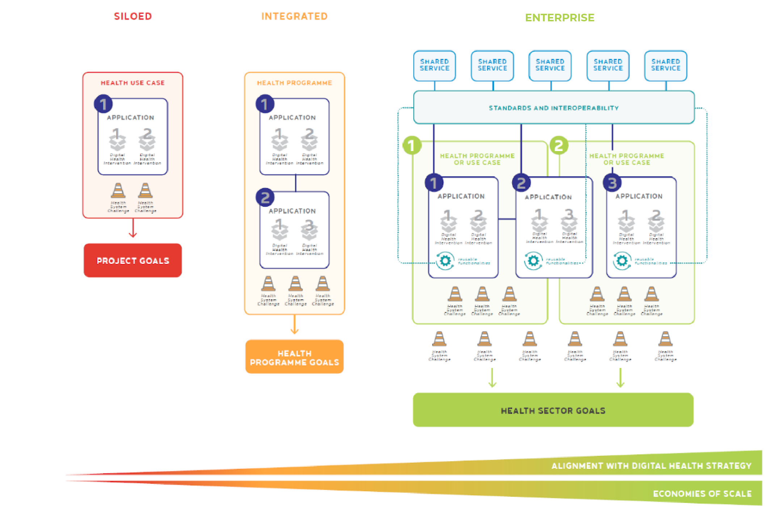
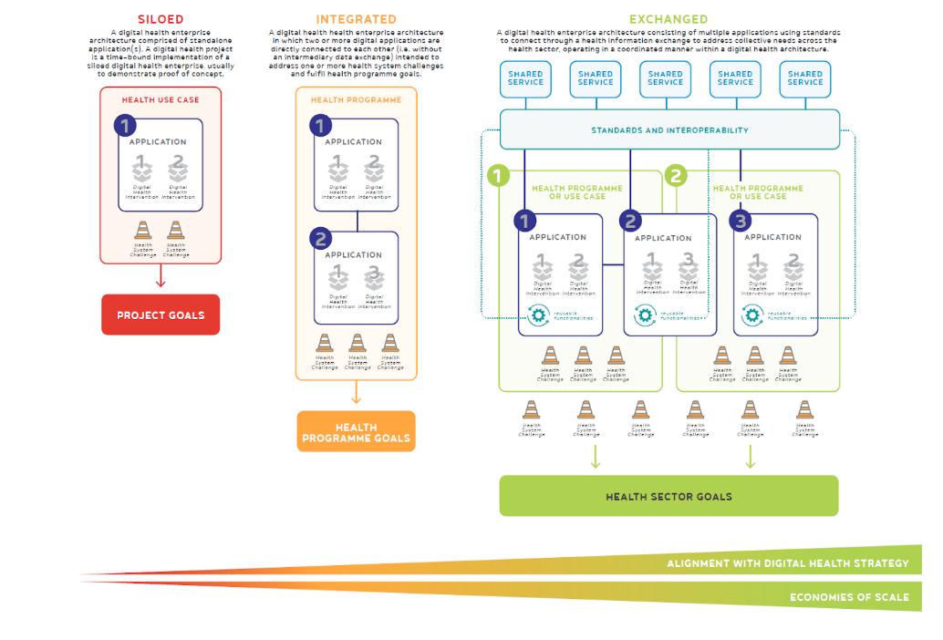
Moving away
from siloed
systems

Slide 30
Digital Health Platform: continuum of care
A Digital Health Platform enables patient-centered care instead of the current models of disease or facility-based care
Notes:
ENGAGEMENT:
TRANSITION:
RECAP:
ANECDOTE:
Speaker Notes: key message, you cannot track the patient longitudinally through care. The patient, if tested at both the clinic and referral clinic will count at 2 separate cases of HIV destroying your denominator
Citation: Malawi Example Paper

Slide 31
Take home massage
Support implementation of the digital health strategy
Develop common understanding of importance of digital health within our units/ sections (championing digital health)
Accountability on using of digital health solution to improve health outcome
Streamline stakeholders and partners digital health priorities with National DH priorities
Streamline efforts and resources toward supporting DH strategic priorities.
Notes:
ENGAGEMENT:
TRANSITION:
RECAP:
ANECDOTE:
Speaker Notes:
Citation:

Slide 32
THANK YOU!

